Slide 1

CMR TECHNICAL CAMPUS
STUDENT RESULT MANAGEMENT SYSTEM
PRESENTED BY :
M.Siva Yamini(197R1A0537)
R.Rakshith(197R1A0547)
B.Sai Charan(197R1A0506)
PROJECT GUIDE :
Punyaban Patel

Slide 2
ABSTRACT
Student Result Management System provides a simple interface for the maintenance of student details. It can be used by educational institutes or colleges to maintain the records of students easily. It manages the information about various students enrolled in different courses. Progress of the student will be available through a secure, online interface embedded in a web application.
And Students and Admins are allowed to login with their respective details and passwords assigned by them.

Slide 3

INTRODUCTION
The Student Result Management System handles all the details about a Student in our Web-Application designed. The details include Course details, Personal details, Academic details of students across multiple branches etc.,.There is a process to manage the student result by using admin panel. We provide many other options which are helpful for the students. Students can search their result using a valid roll.id.

Slide 4
EXISTING SYSTEM
Teachers usually spend one to two days on each student before they grade their papers,then they plot the results on a graph and determine which student ranks on the top.This is a very time consuming process and its prone to human error.

Slide 5
ADVANTAGES
Student Result Management System divided in two modules:-
Student
Admin
Admin Features:
Admin can add/update/ Active/Inactive Subject with class.
Admin can register new student and also edit information of the student.
Student can view and download their results.
DISADVANTAGES
In comparison to the WAMP server, configuration and setting are more difficult

Slide 6
Proposed System:
SRMS(STUDENT RESULT MANAGEMENT SYSTEM) is a Multi User system it manages the information about various students enrolled in different courses, marks obtained by various students in various subjects.
Students can check their results by entering their respective roll ids and class.
Students can get their results downloaded at the same time.
Admins are allowed to make changes like add, edit or delete to the various data and also update the results.
Admins can also create new users and make changes in their profile details.

Slide 7
SOFTWARE REQUIREMENTS
Operating System : Windows XP
Front-End : HTML,PHP
Database : MYSQL
HARDWARE REQUIREMENTS
Processor : Intel Pentium 4.0
RAM : 2GB
Hard Disk : 500GB

Slide 8
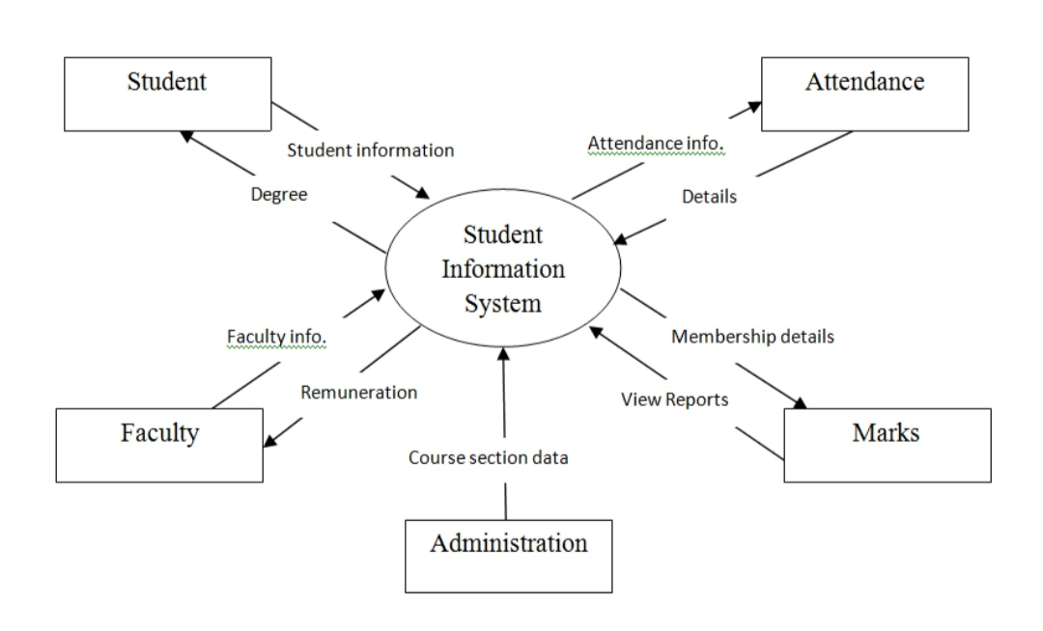
Module:
The main purpose of Student Result Management System is to perform Student Details, Marks, Attendance, Faculty etc...

Slide 9
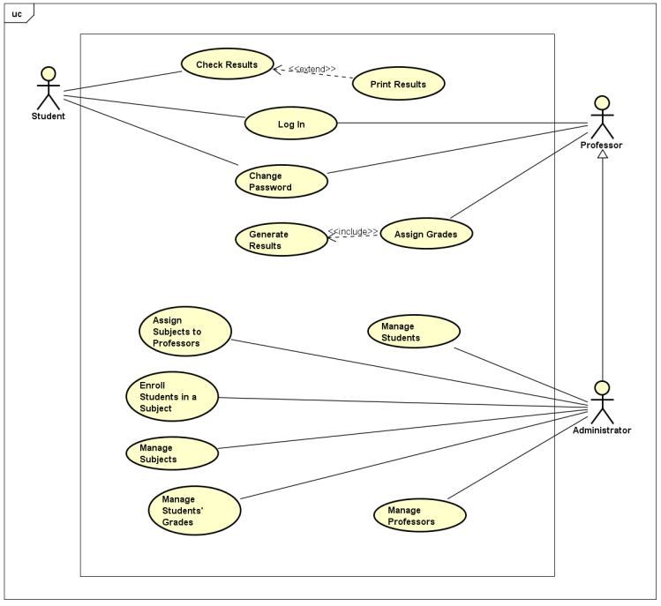
UML Diagrams:
Use case diagram:

Slide 10
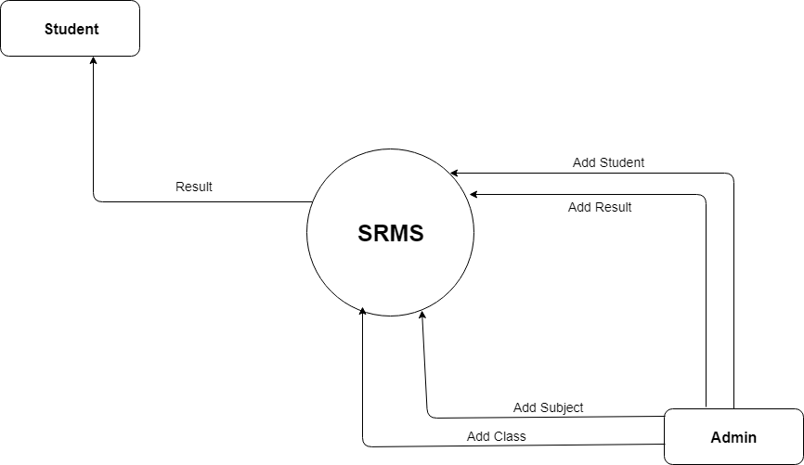
Class Diagram :

Slide 11
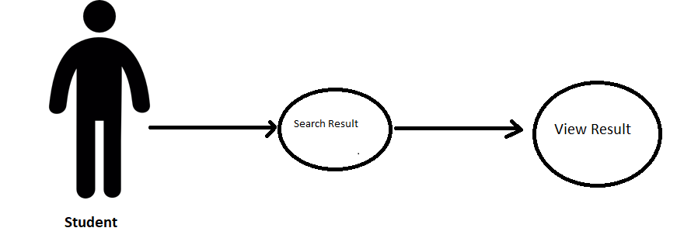
Student case Diagram:

Slide 12
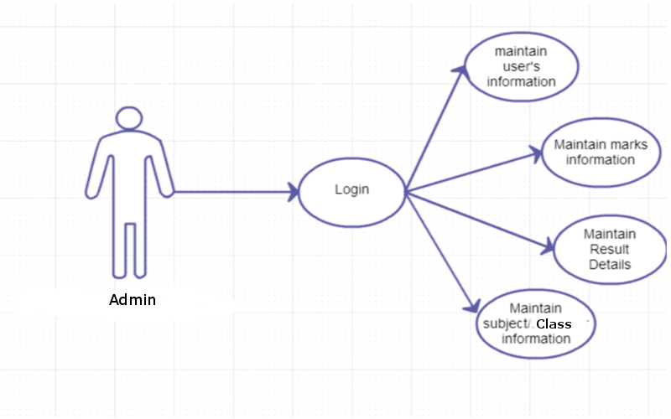
Admin Case Diagram:

Slide 13
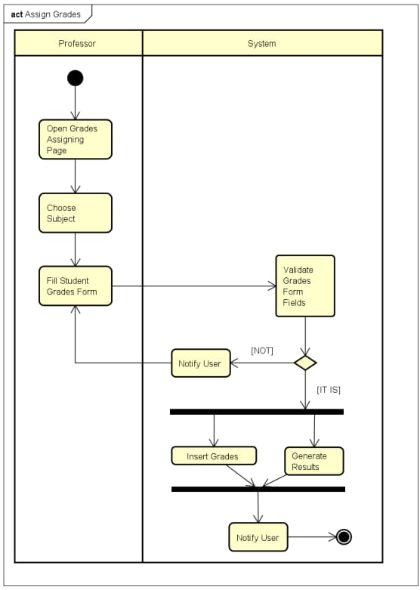
Activity Diagram:

Slide 14
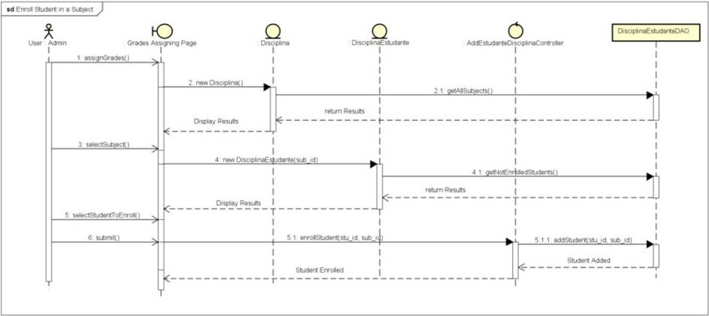
Sequence Diagram:

Slide 15
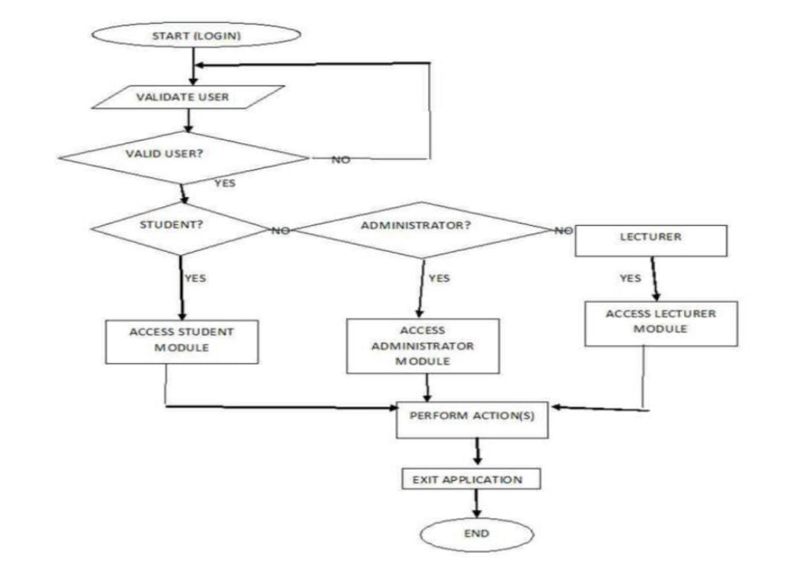
Flow chart:

Slide 16
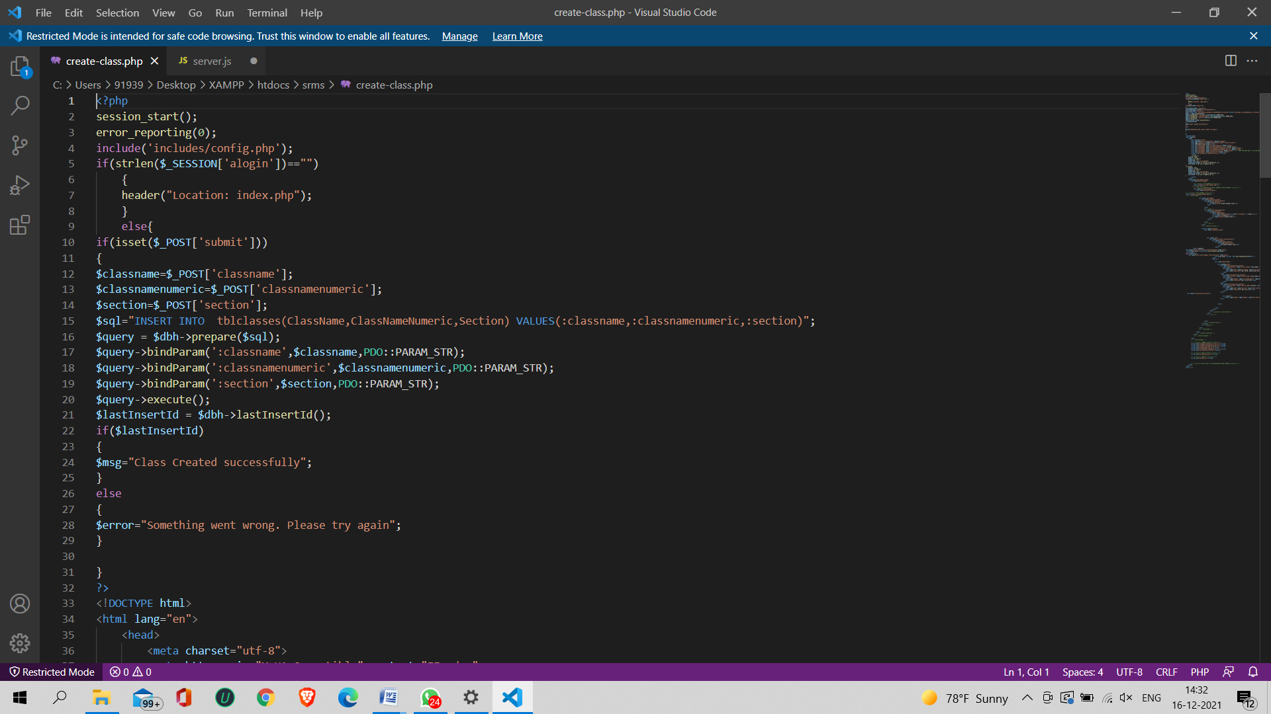
Code Implementation:
Creating a Class

Slide 17
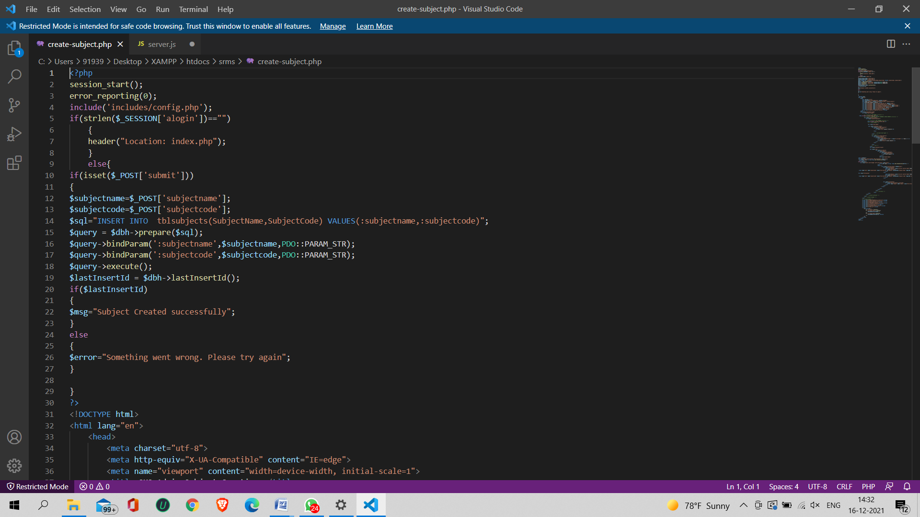
Creating a Subject:

Slide 18
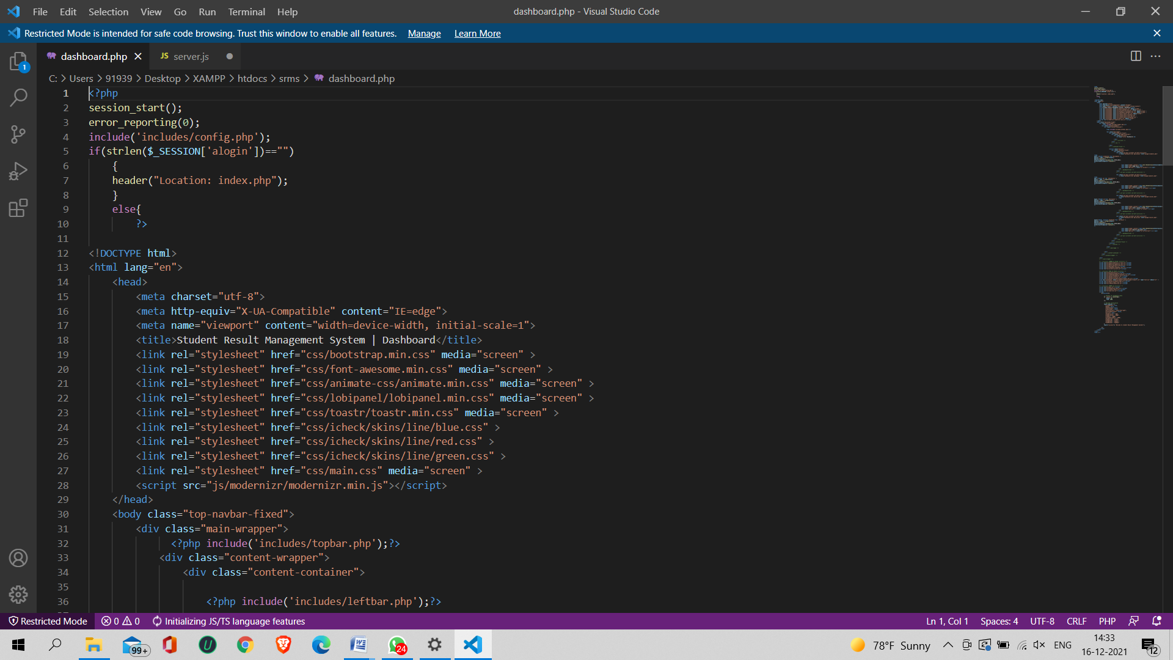
Creating a Dashboard:

Slide 19
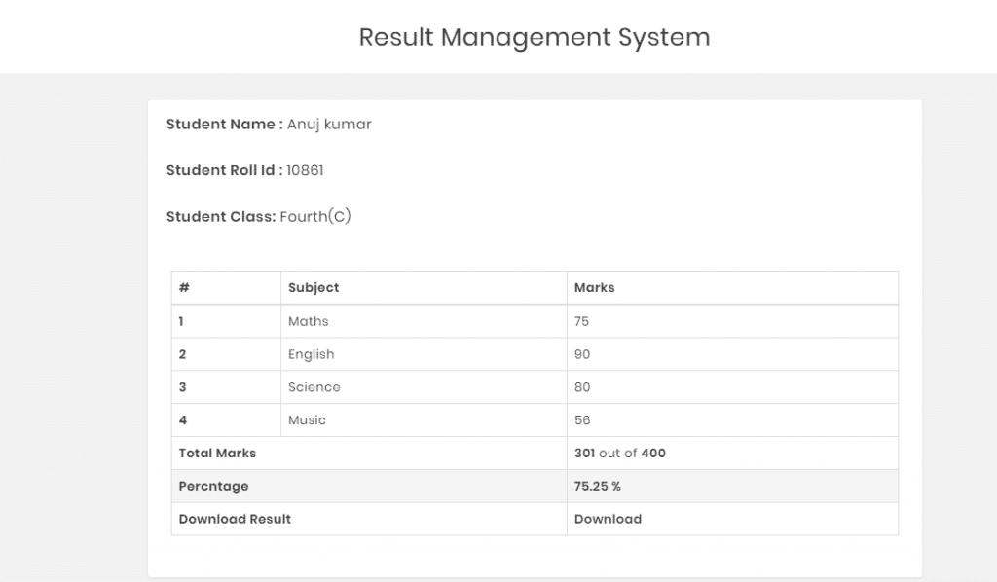
Student result page

Slide 20
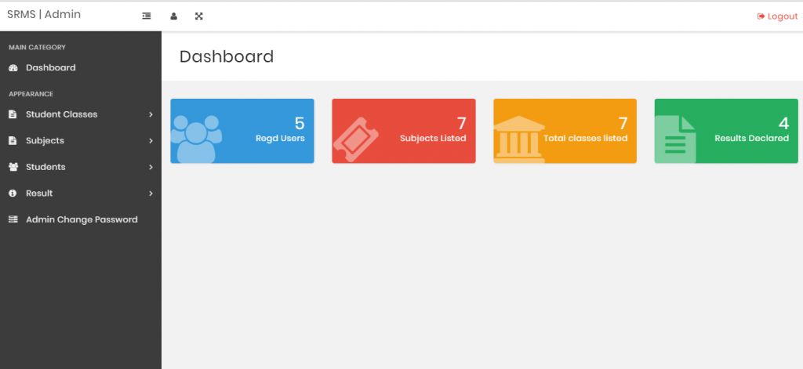
DASHBOARD:

Slide 21
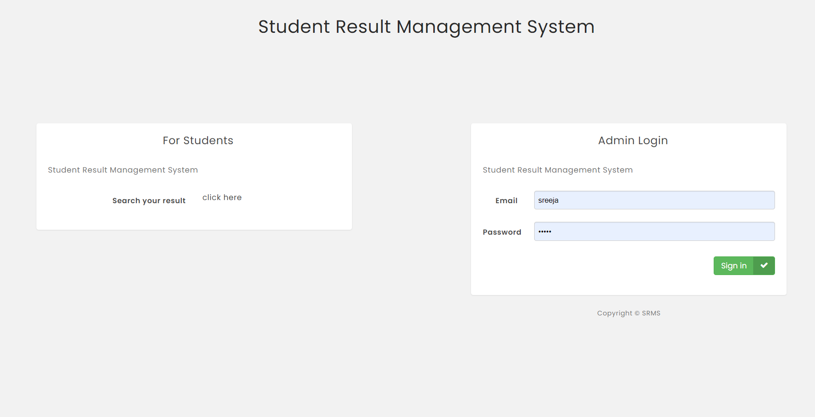
RESULT:
Login page

Slide 22
CONCLUSION
The project entitled as STUDENT RESULT MANAGEMENT SYSTEM is a system that handles the students information regarding student results, profile details.
It is successfully implemented with all the features mentioned.
The project is designed keeping in view that the problems faced by schools, institutions.
Deployment of our application will certainly help the schools, instiutions to reduce unnecessary wastage of time and paperwork in maintaining all the information.

Slide 23
Future Enhancement
With the technology and urbanization, modern needs are rapidly growing, In order to keep the software the performance of the software streamlined as per the growing requirements, it always better to keep adding new features to your tech stack. There are three integral features that should be embedded in SRMS
Cloud Based Software
Information Security
Integrations

Slide 24
REFERENCES
https://phpgurukul.com/student-result-management-system/#google_vignette
https://www.webslesson.info/2020/12/online-student-result-management-system-in-php-with-mysql.html
https://youtu.be/jTKIeERY4hA
http://stackoverflow.com/
http://www.w3schools.com/
http://www.tutorialspoint.php

Slide 25
THANK YOU…!

